Slide 1
Logistic Regression

Slide 2

Classification and Representation
Classification
  Example:
    Email: Spam / Not Spam?
    Online Transactions: Fraudulent (Yes/No)?
    Tumor: Benign / Malignant?
  Binary Classification
    $h\left(x\right)→y, y ε \left\{0, 1\right\}$
0: Negative Class
1: Positive Class

Slide 3
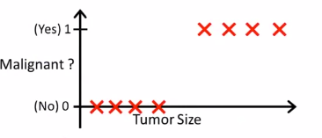
Classification and Representation
Classification
  Solving classification as a regression problem

Slide 4
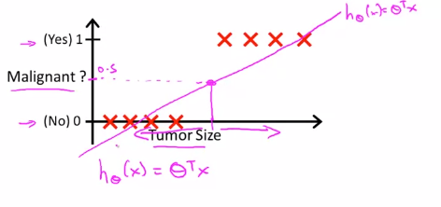
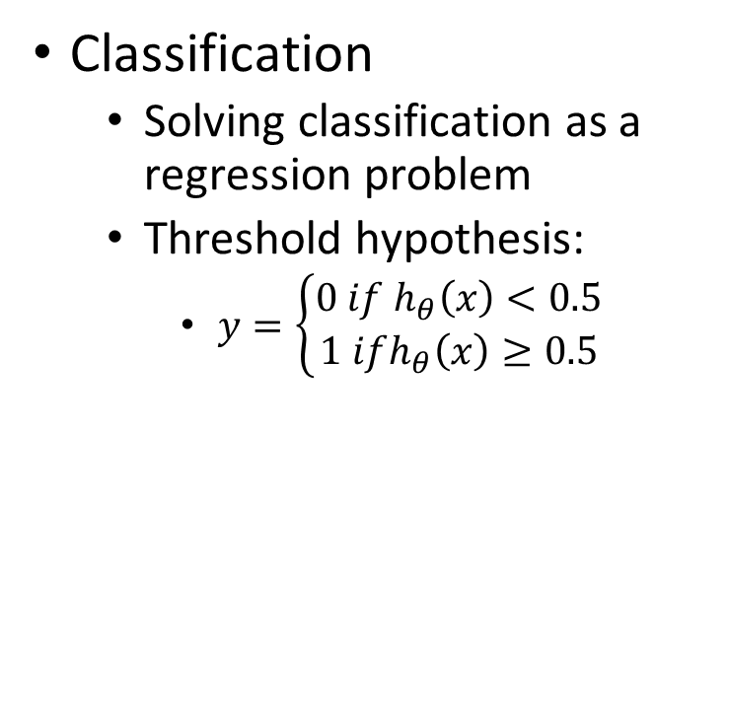
Classification and Representation
Classification
  Solving classification as a regression problem
  Threshold hypothesis:
    $y=\left\{\begin{aligned}0 if h_{θ}\left(x\right)<0.5 \\ 1 ifh_{θ}\left(x\right)≥0.5\end{aligned}\right.$

Slide 5
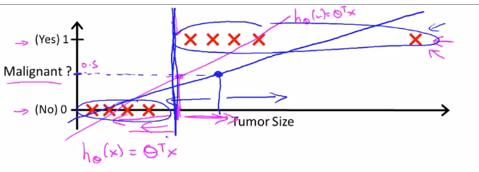
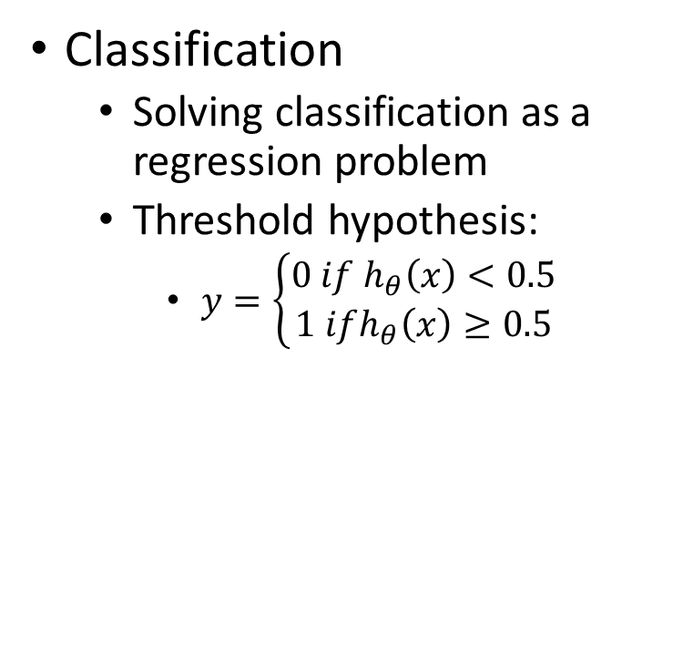
Classification and Representation
Classification
  Solving classification as a regression problem
  Threshold hypothesis:
    $y=\left\{\begin{aligned}0 if h_{θ}\left(x\right)<0.5 \\ 1 ifh_{θ}\left(x\right)≥0.5\end{aligned}\right.$

Slide 6

Classification and Representation
Classification
  $y ε \left\{0, 1\right\}$
  Hypothesis value range: $h_{θ}\left(x\right) ∈R$
  Logistic Regression: $0≤h_{θ}\left(x\right)≤1$

Slide 7
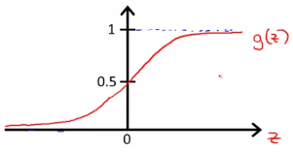

Classification and Representation
Hypothesis Representation
  Logistic Regression Model
    $0≤h_{θ}\left(x\right)≤1$
    $h_{θ}\left(x\right)=g(θ^{T}x)$
    $g\left(z\right)= \frac{1}{1+e^{−z}}$
    $h_{θ}\left(x\right)=\frac{1}{1+e^{−θ^{T}x}}$
    $0≤h_{θ}\left(x\right)<1$

Slide 8

Classification and Representation
Hypothesis Representation
  $h_{θ}\left(x\right)$ = estimated probability that y = 1, given input x
  $h_{θ}\left(x\right)=P\left(y=1\right|x, θ)$
  $P\left(y=1\right|x, θ)+P\left(y=0\right|x, θ)=1$

Slide 9
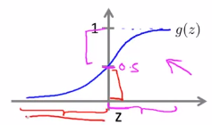

Classification and Representation
Decision Boundary
  Boundary = 0.5
  $y=\left\{\begin{aligned}0 if h_{θ}\left(x\right)<0.5 \\ 1 ifh_{θ}\left(x\right)≥0.5\end{aligned}\right.$
  $y=\left\{\begin{aligned}0 ifθ^{T}x<0 \\ 1 ifθ^{T}x≥0\end{aligned}\right.$

Slide 10
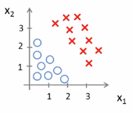

Classification and Representation
Decision Boundary
  $h_{θ}\left(x\right)=g(θ_{0}+ θ_{1}x_{1}+θ_{2}x_{2})$
  $θ=\begin{matrix}−3 \\ 1 \\ 1\end{matrix}$
  $y=1 if −3+x_{1}+x_{2}≥0$

Slide 11
Classification and Representation
Decision Boundary
  $h_{θ}\left(x\right)=g(θ_{0}+ θ_{1}x_{1}+θ_{2}x_{2})$
  $θ=\begin{matrix}−3 \\ 1 \\ 1\end{matrix}$
  $y=1 if −3+x_{1}+x_{2}≥0$

Slide 12
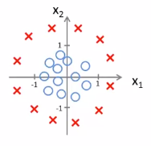
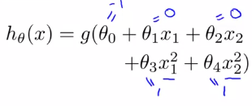

Classification and Representation
Non-linear Decision Boundary
  $y=1 if −1+x_{1}^{2}+x_{2}^{2}≥0$

Slide 13
Classification and Representation
Non-linear Decision Boundary
  $y=1 if −1+x_{1}^{2}+x_{2}^{2}≥0$

Slide 14
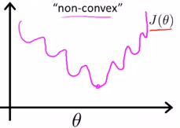
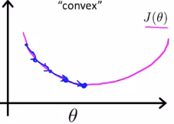

Logistic Regression Model
Cost function
  Logistic model:
    $h_{θ}\left(x\right)=\frac{1}{1+e^{−θ^{T}x}}$
  Mean Square Error
  What we want

Slide 15

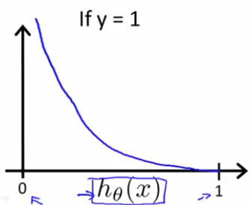

Logistic Regression Model
Cost function
  $Cost=0 if y=1, h_{θ}\left(x\right)=1$
  $Cost → +∞ ifh_{θ}\left(x\right)→0$

Slide 16
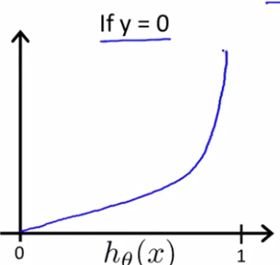

Logistic Regression Model
Cost function
  $Cost=0 if y=0, h_{θ}\left(x\right)=0$
  $Cost → +∞ ifh_{θ}\left(x\right)→1$

Slide 17

Logistic Regression Model
Simplified Cost Function
  $y ∈\{0, 1\}$
  $Cost\left(h_{θ}\left(x\right), y\right)= −ylog\left(h_{θ}\left(x\right)\right) −\left(1 −y\right)log⁡(1 −h_{θ}\left(x\right))$

Slide 18
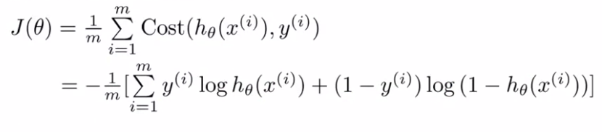

Logistic Regression Model
Simplified Cost Function
Gradient
  $\frac{∂}{∂θ_{j}}J\left(θ\right)= \frac{1}{m} \sum_{i=1}^{m}{\left(h_{θ}\left(x^{\left(i\right)}\right)−y^{\left(i\right)}\right)x_{j}^{(i)}}$

Slide 19

Logistic Regression Model
Advanced Optimization
  Gradient Descent
  Conjugate gradient
  BFGS
  L-BFGS
Advantages:
  No need to choose $α$
  Faster than gradient descent
Disadvantages:
  More complex

